Slide 1
Surah Al-Ikhlas سورة الإخلاص
Prepared by Azamat Salamatov

Slide 2
Table of contents
History
Explanation
01
02
Virtues
Scientific Miracles
03
04
Nüzul Tarihi
Tafsir
Faziletler
Mücizeler

Slide 3
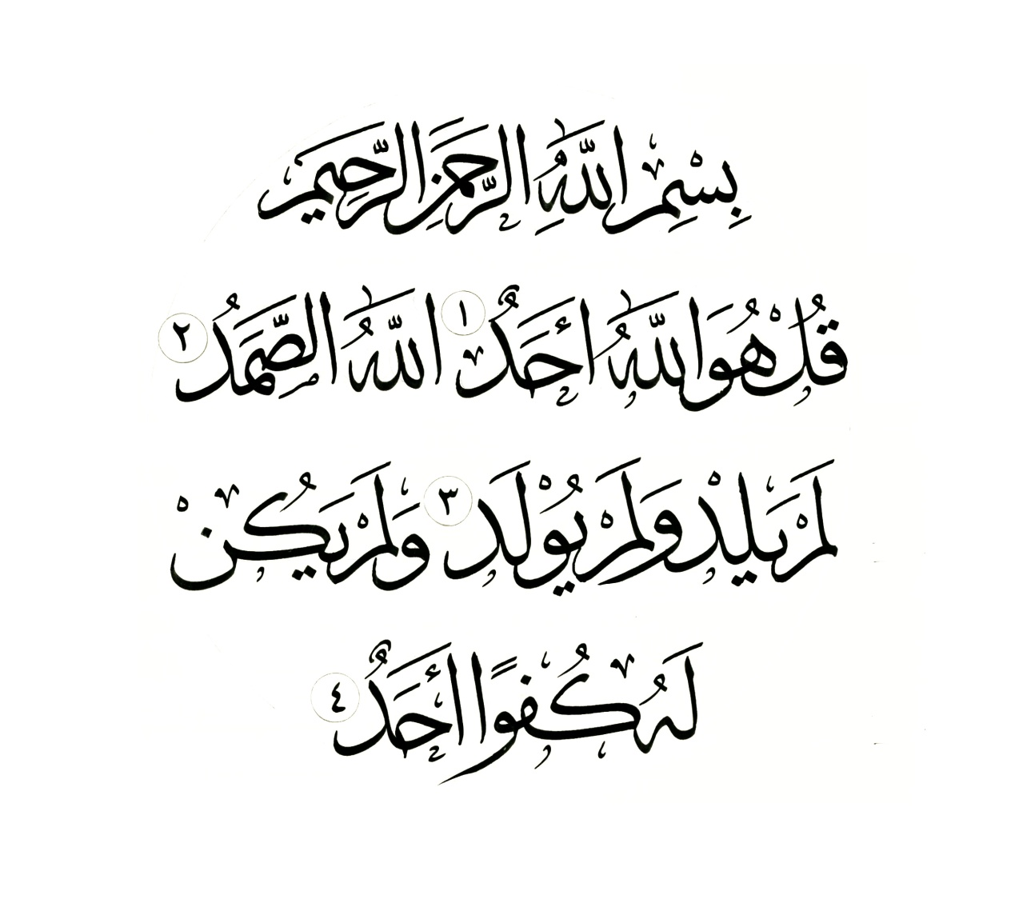
Surah Al-Ikhlas
Say, ˹O Prophet,˺ “He is Allah—One ˹and Indivisible˺;
Allah—the Sustainer ˹needed by all˺.
He does not beget(give birth), nor was He begotten(born).
And there is none comparable to Him.”

Slide 4
—Prophet Muhammad f (al-Bukhari M. Sahih al-Bukhari. In 5 vols. V. 3. P. 1616, hadith No. 5013)
“I swear by Allah, truly, it [surah al-Ikhlas] is equal to a third of the Quran [in meaning and Divine retribution!]”

Slide 5
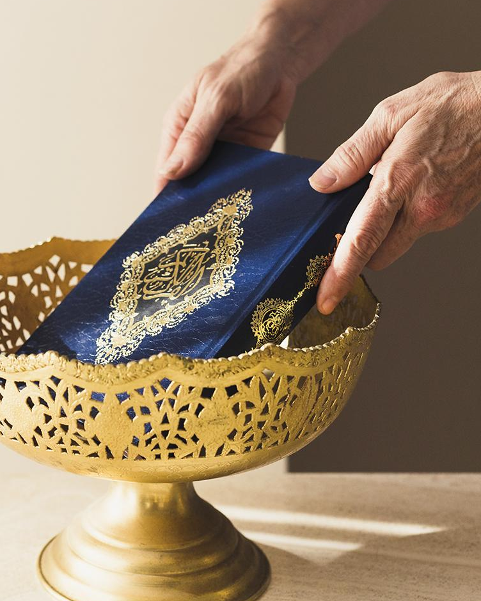
01
History
Nüzul

Slide 6
Meaning And History
01
02
Meaning
Occasions on Revelation
"A Jew asked the holy Prophet to describe the identity or to relate the geneology of Allah. He remained silent and gave no answer for three days, then, the Messenger Angel brought (him) this Surah and he gave them their answer.” (Majma'-al-Bayan, vol. 10, p. 564.) Another narration says that the pagans of Mecca asked such a question. (Al-Mizan, vol. 20, p. 546.) In some narrations it is also said that the Christians of Najran asked the question. There is no contradiction in these narrations because the question may have been asked by all of them, separately, which is, itself, an evidence to the extraordinary importance of this Surah, which answers the questions of different persons from various groups.
This Surah, as its name indicates, is about the Unity of Allah, and His Oneness. In its four verses, the Surah describes monotheism completely.
Other Meanings:
Sincerity, Purity

Slide 7
2. Explanation
Say: “He, Allah (God, Lord), is One [there are no other gods, deities besides Him].
Allah (God, Lord) is Eternal [only He is the One in whom all will need to infinity].
Did not give birth and was not born.
And no one can equal Him [be like Him; there is nothing like Him.]

Slide 8
3. Virtues
The Prophet Muhammad (peace and blessings of Allah be upon him) once asked his companions:
"Can you read a third of the Qur'an in a night?"
It seemed hard to them. They replied:
“O Messenger of Allah, who among us is able to read so much in a night?! [It is very difficult]".
Then the Messenger of Allah said: “Surah al-Ikhlas is a third of the Quran”.(See, for example: al-Bukhari M. Sahih al-bukhari [Collection of hadiths of Imam al-Bukhari]. In 5 volumes. Beirut: al-Maqtaba al-‘asriyya, 1997. Vol. 3. P. 1616, hadith No. 5015.)

Slide 9
3. Virtues
In another reliable hadith, there are the following words of the Prophet: “I swear by Allah, truly, it [surah al-Ikhlas] is equal to a third of the Quran [in meaning and Divine retribution]!”(al-Bukhari M. Sahih al-Bukhari. In 5 vols. V. 3. P. 1616, hadith No. 5013)

Slide 10
3. Virtues
One of the companions once said to the Prophet Muhammad: “O Messenger of Allah, I love the surah “Qul huwal-lahu ahad” [that is, the surah al-Ikhlas]. The Prophet said: “Indeed, love for it [reverent and respectful attitude towards it; frequent recitation in prayer] led you to Paradise”. (Collection of hadiths of at-Tirmidhi and al-Bukhari. See, for example: Nuzha al-muttakin. Sharh riad as-salihin [Walk of the righteous. Commentary on the book "Gardens of the Good"]. In 2 volumes. Beirut: al-Risalya, 2000. Vol. 2. P. 14, Hadith No. 5/1013; al-Bukhari M. Sahih al-bukhari [Code of Hadith of Imam al-Bukhari]. In 5 vols. Beirut: al-Maqtaba al-‘asriyya, 1997. Vol. 1. P. 238, hadith No. 774; al-Bukhari M. Sahih al-bukhari [Code of Hadith of Imam al-Bukhari]. Riyadh: al-Afkyar ad-dawliyya, 1998, p. 160, hadith no. 774; at-Tirmizi M. Sunan at-tirmizi [Code of Hadith of Imam at-Tirmizi]. Riyadh: al-Afkyar ad-dawliyya, 1999. P. 463, hadith no. 2901, "hasan sahih".)
Only the prophets and messengers of the Creator could give such information. Only they had a vision of the future, only before them did the Lord open the veil of the eternal.

Slide 11
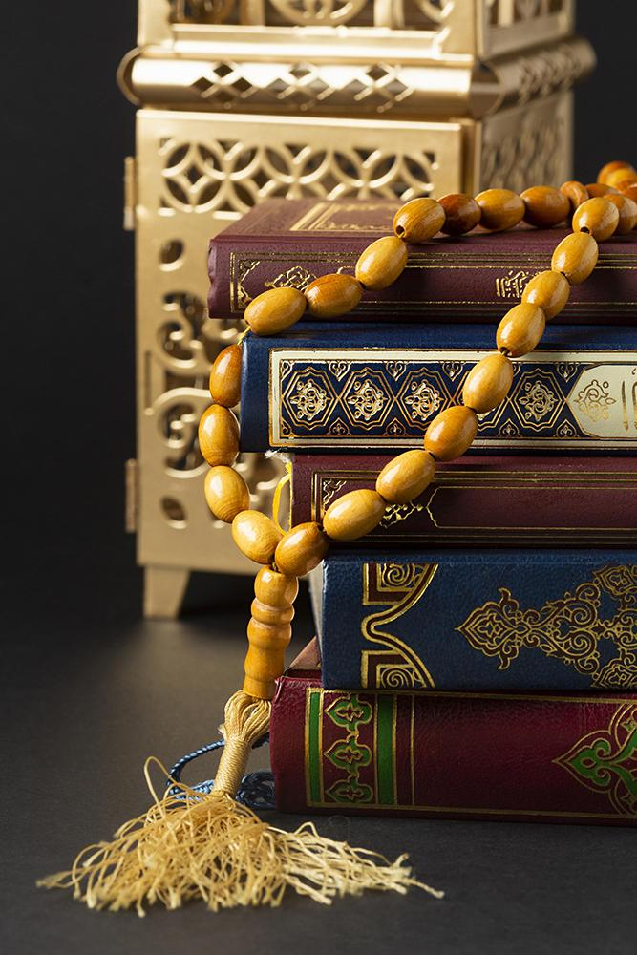
4. Scientific Miracles
#1

Slide 12
Scientific Miracles
Al-AHAD
As-SAMAD
1) Who is Not Made up of Components, Elements
2) All Alone, to Whom there is No Second
Who Does Not Need Anyone, Rather, Everyone is in Dire Need of Him
This is the Only Surah, that Mention these Two Attributes of All-Mighty Allah

Slide 13
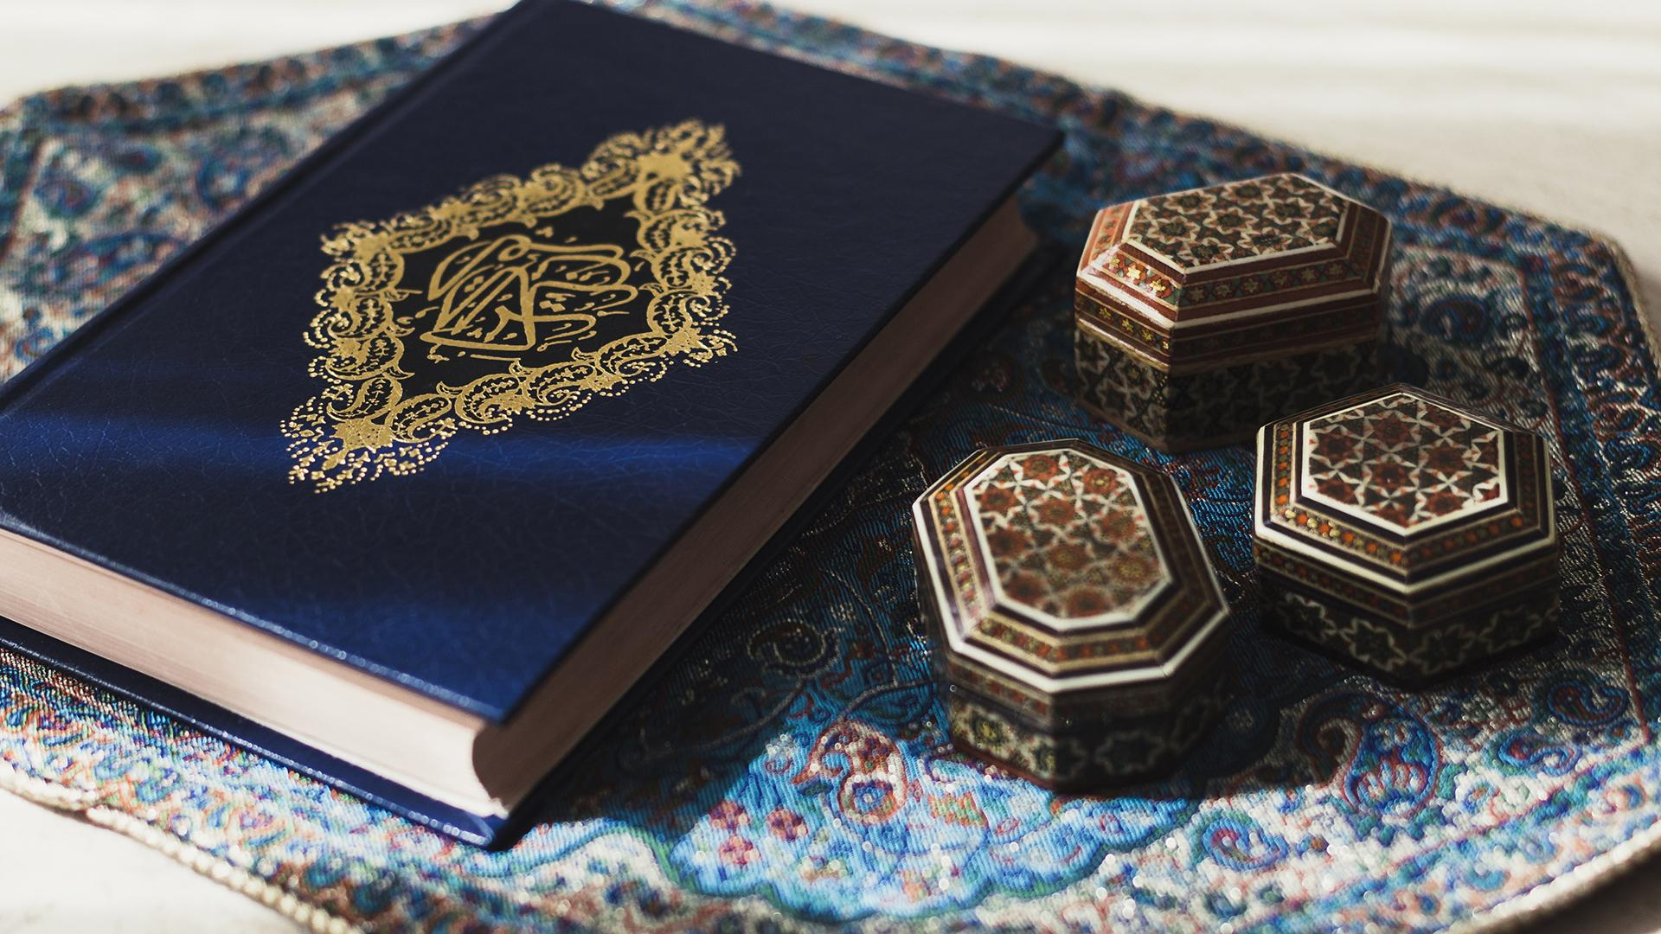
#2

Slide 14
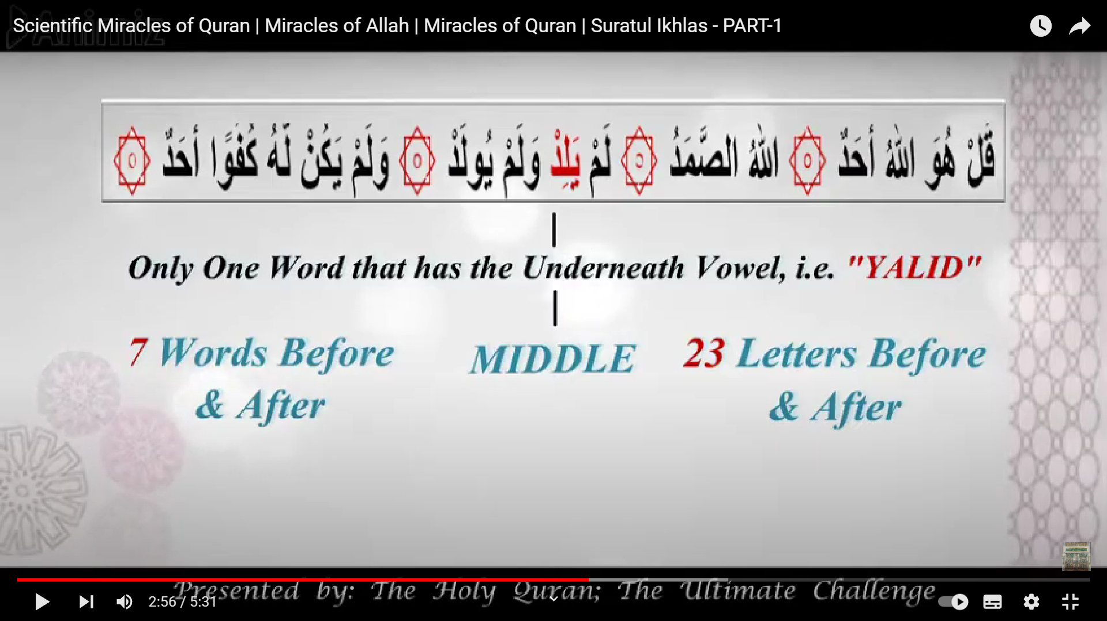
Scientific Miracles
Only One Word that has the Underneath Vowel, Kasrah, i.e. Yalid
MIDDLE
7 Words Before & After
23 Letters Before & After

Slide 15
Here are more numbers
25 times
1 time only
Surah Al-Ikhlas & Surah Aali-Imran
Both Prophet Adam and Prophet Isa are mentioned in Quran
Adam and Isa
are mentioned together in Surah Aali-Imran
Ikhlas : 3rd from the End
Aali-Imran : 3rd from the Beginning

Slide 16
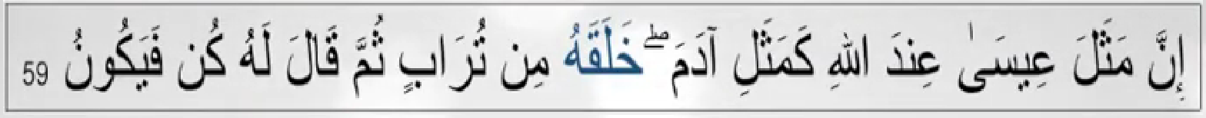
Scientific Miracles
Allah is not Born, and does not give birth
Al-Ikhlas
Aali-Imran: 59
Both Adam & Isa were Created by Allah
Verily, the example of Isa before Allah is like the example of Adam. He Created him from dust, then (He) said to him: “Be!” – and he was.
He does not Beget (give birth), nor he is begotten
15 Words
47 Letters

Slide 17
Thank you!
Do you have any questions?

